Slide 1
What is an operating system?
What does the operating system do?
著作權所有 © 旗標出版股份有限公司

Slide 2
1-1 Hardware - the composition of a computer system
Users
Users
Users
Users
Users
spreadsheets compilers document databases computer games
editors
System programs and applications
operating system
Hardware

Slide 3
1-1 Operating system structure
What is an operating system?
  A set of system software in a computer system that is used to manage hardware and other software in the entire computer system
  Serve as a bridge between users and hardware
The operating system is designed for：
  Simplicity
  Efficiency
  Evolution
著作權所有 © 旗標出版股份有限公司

Slide 4
operating system kernel（Kernel）
Responsible for important functions that are essential for computer operation，included：
  Trip management
  Memory management
  File system management
  Device management
  Strictly speaking, the operating system kernel is more like a library, and the functions it contains are invoked in system calls, interrupts, or exception interrupts

Slide 5
Is the browser part of the operating system?

Slide 6
Why learn operating systems?
Best design examples for resource utilization
It helps to understand the operation and limitations of the program
It helps to make better system management

Slide 7
Types of operating systems
Batch operating system：The supervisor resides in memory and is responsible for reading a job into memory from the input device and handing over control to this task。
Multi-programming system：By putting several tasks in system memory at the same time, you can let the CPU perform other tasks while one task is busy with I/O
What changes are needed for this evolution?

Slide 8
Types of operating systems（Continued）
Time-sharing operating system：It provides the ability to interact with the process and the user
personal computer operating system：The main development direction is to take the convenience and responsiveness of users

Slide 9
Microkernel technology
(microkernel)
Very small core programs
All unnecessary modules in the originally huge core were removed as much as possible, and servo processes were used to provide higher-level functions
Only functions such as process management, memory management, and inter-process communication are left in the kernel
System calls that use inter-process communication to send service requests to file system servo processes

Slide 10
Will virtualization be safer?
Proponents believe that virtualization, even if one of the operating systems is infected with a virus, it will not spread to other virtual machines, so it can provide better security
In fact, when a virtual machine is compromised or compromised, other virtual machines located on the same physical host are also at risk. In addition, the virtual environment itself can be a target

Slide 11
Xen system
The virtual machine developed by the University of Cambridge Computer Laboratory can simulate multiple operating system environments on the same hardware
The resource consumption of the system is extremely low, and it is endorsed and contributed by open source software and many vendors
著作權所有 © 旗標出版股份有限公司

Slide 12
Figure 1-6 Xen system architecture
Device management
application
application
application
Visitor OS1
Visitor OS2
Visitor OS3
Visitor OS4
Original device
drivers
Xen Hypervisor
Hardware (CPU, memory, network, disk)

Slide 13
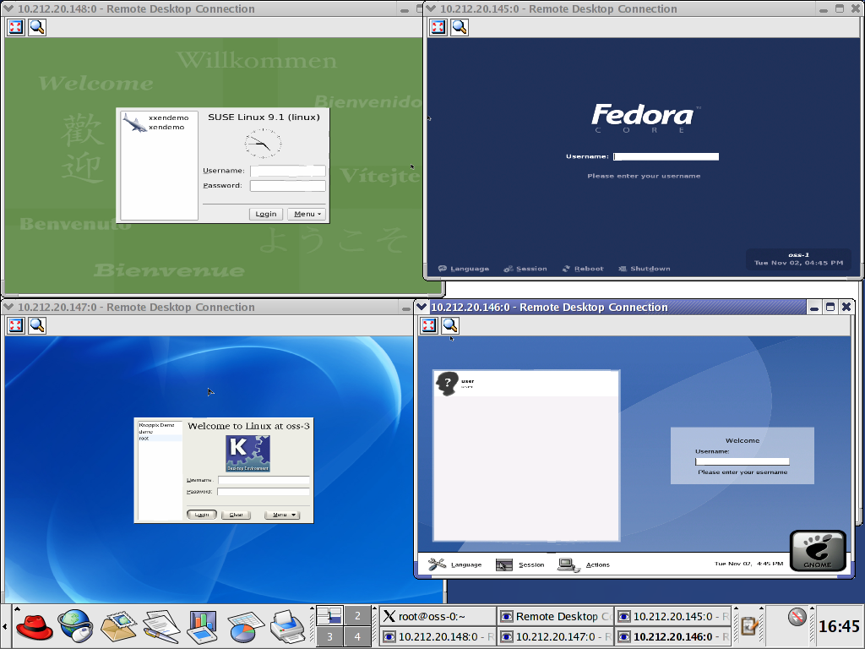
Figure 1-7 A total of 5 Linux versions of Xen are running

Slide 14
Figure 1-8 CPU composition
CPU
A command in the Memory Program section
Arithmetic logic
unit
Program counters
CPU operating process
Instruction register
Control logic
command extraction
command decoding
Data extraction
command execution
Data storage
Program state words
register

Slide 15
What is a register?
The small memory in the CPU is much faster to access than the main memory, but it stores much less data than the main memory
It can be divided into 3 categories：
  Data registers: Used to temporarily store data required for instruction operations
  Address registers: Used to store address-related information, including index registers, segment pointer registers, stack pointer registers, etc
  State and control registers: such as program counters, command registers, and program state words that record state information

Slide 16
Figure 1-9 Example of a simplified computer command
opcode
memory address
(a) Instruction format
opcode | Description
0000 | Load data from memory into register A
0001 | Loads data from memory into register B
0010 | Add the values of registers A and B and put them into register A
0011 | Writes the value in register A to memory
(b) List of the first 4 operns

Slide 17
Figure 1-10 Command execution example (1)
memory
register
memory
register
100
0 2 1 6
1 0 0
PC
100
0 2 1 6
1 0 2
PC
102
1 2 1 8
0 2 1 6
IR
102
1 2 1 8
0 2 1 6
IR
104
2 0 0 0
registerA
104
2 0 0 0
0 0 0 1
registerA
106
3 2 1 6
registerB
106
3 2 1 6
registerB
216
0 0 0 1
216
0 0 0 1
218
0 0 1 6
218
0 0 1 6
Command to retrieve address 100
(Loading data from memory into register A)
(b) Retrieve data for address 216

Slide 18
Figure 1-10 Command execution example (2)
memory
register
memory
register
100
0 2 1 6
1 0 2
PC
100
0 2 1 6
1 0 4
PC
102
1 2 1 8
1 2 1 8
IR
102
1 2 1 8
1 2 1 8
IR
104
2 0 0 0
0 0 0 1
registerA
104
2 0 0 0
0 0 0 1
registerA
106
3 2 1 6
registerB
106
3 2 1 6
0 0 1 6
registerB
216
0 0 0 1
216
0 0 0 1
218
0 0 1 6
218
0 0 1 6
(c) Command to retrieve address 102
(Loading data from memory into register B)
(d) Retrieve data for address 218

Slide 19
Figure 1-10 Command execution example (3)
memory
register
memory
register
100
0 2 1 6
1 0 4
PC
100
0 2 1 6
1 0 6
PC
102
1 2 1 8
2 0 0 0
IR
102
1 2 1 8
2 0 0 0
IR
104
2 0 0 0
0 0 0 1
registerA
104
2 0 0 0
0 0 1 7
registerA
106
3 2 1 6
0 0 1 6
registerB
106
3 2 1 6
0 0 1 6
registerB
216
0 0 0 1
216
0 0 0 1
218
0 0 1 6
218
0 0 1 6
(e) Command to retrieve address 104
(A+B->A)
(f) Put the value of A+B back into register A

Slide 20

Figure 1-10 Command execution example (4)
memory
register
memory
register
100
0 2 1 6
1 0 6
PC
100
0 2 1 6
1 0 8
PC
102
1 2 1 8
3 2 1 6
IR
102
1 2 1 8
3 2 1 6
IR
104
2 0 0 0
0 0 1 7
registerA
104
2 0 0 0
0 0 1 7
registerA
106
3 2 1 6
0 0 1 6
registerB
106
3 2 1 6
0 0 1 6
registerB
216
0 0 0 1
216
0 0 1 7
218
0 0 1 6
218
0 0 1 6
(g) Command to retrieve address 106
(Writes the value in register A to memory)
(h) Write the data back to address 216

Slide 21
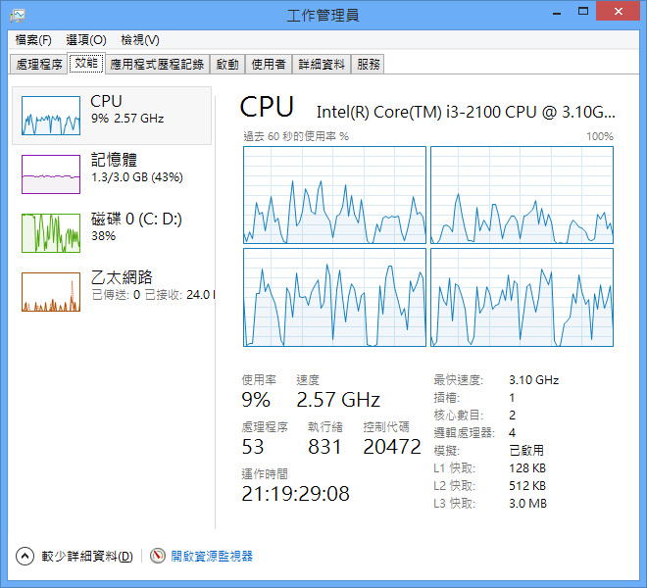
Figure 1-11 Example of dual-core CPU performance display in Windows Task Manager

Slide 22
Interrupter
A signal sent to the CPU by a peripheral or timer represents an event that needs to be processed as quickly as possible
The handling of interrupt events cannot interfere with the execution results of the user program
Interruption handling：
  The CPU completes the current instruction first
  Before processing an interrupt, the individual flag and register contents of the original program must be saved and restored after processing is complete.
  Jump out of the normal execution steps, execute the interrupt handler, and complete the handling of the interrupt event
  Then return to the original program and continue executing the next command

Slide 23
Figure 1-13 Changes in program counters during interrupt processing
memory
memory
memory
100
100
100
100
100
0 2 1 6
100
0 2 1 6
0 2 1 6
0 2 1 6
0 2 1 6
0 2 1 6
102
102
102
102
102
1 2 1 8
102
1 2 1 8
1 2 1 8
1 2 1 8
1 2 1 8
1 2 1 8
104
104
104
104
104
2 0 0 0
104
2 0 0 0
2 0 0 0
2 0 0 0
2 0 0 0
2 0 0 0
106
106
106
106
106
3 2 1 6
106
3 2 1 6
3 2 1 6
3 2 1 6
3 2 1 6
3 2 1 6
Interrupt the handler
Start address
A00
0 2 1 6
A00
A00
0 2 1 6
0 2 1 6
0 2 1 6
0 2 1 6
0 2 1 6
A02
1 2 1 8
A02
A02
1 2 1 8
1 2 1 8
1 2 1 8
1 2 1 8
1 2 1 8
System stack
Section
FFC
2 0 0 0
FFC
2 0 0 0
FFC
2 0 0 0
FFE
3 2 1 6
FFE
3 2 1 6
FFE
0 1 0 0
3 2 1 6
0 1 0 0
Program counters
Program counters
Program counters
1 0 0
A 0 0
1 0 0
Before the
outage occurred
(b) when jumping to
the interrupt handler
(c) Keep going
著作權所有 © 旗標出版股份有限公司

Slide 24
Program calls
The process of the program call：
  The CPU first jumps from the originally called program to the called program
  Execute the program being called
  Then jump back to the next command called by the original program and continue to execute

Slide 25
Returns the save of the address
Utilize stacking
  Stacked data structure: last-in, first-out series
  Manage the stack's 3 metrics: stack base, stack limit, and stack metric
著作權所有 © 旗標出版股份有限公司

Slide 26
Figure 1-14 Structure and indicators of the stack
"Push" in
"Pop" out
Stack limit
Not used
reserved
Stack sections
Stack indicators
used
Stack the base
memory
著作權所有 © 旗標出版股份有限公司

Slide 27
Figure 1-15 Nested program calls and stacks
main
ProcedureA
ProcedureB
Call A
(b)
Call B
(c)
Return;
Return;
(e)
(d)
Nested program calls
Procedure A
Return address
Main
Return address
Main
Return address
Main
Return address
The initial state
of the stack
(b) After calling program A
(c) After calling
program B
(d) Return from
Procedure B
(e) Return to the
main program
著作權所有 © 旗標出版股份有限公司

Slide 28
Stack overflow
（stack overflow）
The contents of the stack grow taller with the level of the procedure call
  For example, in a recursive calling program, the boundary conditions for stopping recursion are improperly designed and enter an infinite recursive state
If the stacked space is used up, a stack overflow occurs
著作權所有 © 旗標出版股份有限公司

Slide 29
Figure 16 Execution example of a Linux system call
open()
{
…
int 0x80
…
}
system_call:
…
sys_open()
…
ret_from_sys_call;
…
iret
sys_open()
{
…
}
…
open()
…
User mode
Core mode
System call dispatch table: sys_call_table
EAX register: Stores the system call number

